Slide 1
18EEP301L-MINOR PROJECT – III
DEPARTMENT OF ELECTRICAL AND ELECTRONICS ENGINEERING
IOT BASED FOOD SPOILAGE DETECTION SYSTEM
YEAR | SEMESTER : III | V
BATCH NO : 11
DATE: 24.09.2024
PRESENTED BY :
SANJAI S 927622BEE095
SHANMITHA R 927622BEE104
GUIDED BY:
Mr.M.RAMESH.ME.,
AP/EEE

Slide 2
LIST OF CONTENTS
Abstract
Objective
Description
Problem Statement
Existing system
Proposed System
Block Diagram
Working explanation
Components Used
Future scope
Cost Estimation
Implementation

Slide 3
ABSTRACT
This project develops an IoT-based food spoilage detection system using sensors like DHT11 for temperature and humidity, a methane sensor for spoilage gases, and a moisture sensor for food freshness. An Arduino Uno processes sensor data, compares it with predefined thresholds, and displays alerts (e.g., "Optimal Conditions" or "Spoilage Detected") on an LCD. This cost-effective solution enables real-time food quality monitoring, reduces waste, and ensures better preservation, making it suitable for refrigerators, storage facilities, and marketplaces. It contributes to enhanced food safety and sustainability.

Slide 4
OBJECTIVE
The objective of this project is to develop an IoT-based food spoilage detection system that enhances food quality monitoring and preservation. By integrating methane and moisture sensors, the system aims to accurately detect early signs of spoilage by measuring key indicators such as methane gas concentration and moisture levels. This real-time monitoring solution helps predict spoilage, minimize food waste, and ensure safety in food storage and transportation. The project seeks to provide a cost-effective, user-friendly approach for individuals and industries to maintain food freshness, improve supply chain efficiency, and promote sustainable practices.

Slide 5
DESCRIPTION
This project develops an IoT-based food spoilage detection system using sensors for temperature, humidity, methane gas, and moisture to monitor food quality. An Arduino Uno processes the data and displays alerts like "Optimal Conditions" or "Spoilage Detected" on an LCD. This cost-effective system is ideal for food storage, refrigerators, and marketplaces, helping reduce waste, ensure safety, and promote sustainability.

Slide 6
PROBLEM STATEMENT
Food spoilage leads to significant economic losses, health risks, and increased waste in both home and commercial settings. Traditional monitoring methods are often manual and unreliable, resulting in delayed detection of spoilage. There is a pressing need for an automated system that can continuously monitor food conditions, provide real-time data, and alert users to potential spoilage.

Slide 7
EXISTING SYSTEM
Manual monitoring
Limited sensor use
Lack of real-time alerts
No remote access
Not prioritize Energy efficiency
Single condition focus
Limited integration

Slide 8
PROPOSED SYSTEM
Real-time monitoring
Early detection alerts
Multiple sensor integration
Data storage and analysis
User friendly interface
Energy efficient design
Comprehensive alerts
Scalable solution

Slide 9
BLOCK DIAGRAM
Power Supply
16X2 LCD
Display
MQ4
Methane Sensor
Arduino
UNO
R3
DHT 11
Sensor
Moisture
Sensor

Slide 10
WORKING EXPLANATION
The IoT-based food spoilage detection system operates by integrating multiple sensors to monitor key parameters affecting food quality. The DHT11 sensor measures temperature and humidity, the methane sensor detects spoilage gases, and the moisture sensor assesses the water content in food. These sensors send their data to the Arduino Uno microcontroller, which compares the readings against predefined thresholds. Based on the analysis, the system determines the storage condition and displays real-time results and alerts, such as "Optimal Conditions" or "Spoilage Detected," on an LCD screen. This enables users to take timely actions to prevent spoilage, ensuring food safety and quality.

Slide 11
COMPONENTS USED
Arduino uno MQ-4 Methane Sensor Moisture Sensor DHT11 Sensor 16x2 LCD Display 6. Bread board and jumper wires

Slide 12
COMPONENTS USED
ARDUINO BOARD:
The Arduino Uno is the central processor in this food spoilage detection system. It collects data from sensors for temperature, humidity, methane gas, and moisture, processes the readings, and compares them with predefined thresholds. Based on the analysis, it displays alerts like "Optimal Conditions" or "Spoilage Detected" on an LCD. This cost-effective microcontroller ensures efficient and reliable operation for real-time food quality monitoring.

Slide 13
COMPONENTS USED
MQ-4 ,MOISTURE AND DHT 11 SENSOR:
An IoT-based food spoilage detection system can utilize the MQ-4 gas sensor to detect spoilage gases like methane, the DHT11 sensor for monitoring temperature and humidity, and a moisture sensor to measure moisture levels. High levels of methane, temperature, humidity, or moisture indicate potential spoilage. The system displays real-time data on an LCD screen and triggers a "Spoilage Alert" when any threshold is exceeded. This approach effectively monitors key spoilage factors without requiring a WiFi module.

Slide 14
COMPONENTS USED
16x2 LCD DISPLAY:
The 16x2 LCD display is commonly used in electronics projects to visually display information in a simple and concise format. In the context of a food spoilage detection system, the 16x2 LCD can be utilized to show real-time sensor data such as temperature, humidity, moisture levels, and gas concentrations. With 16 characters per line and 2 lines available, it provides enough space to display key information

Slide 15
FUTURE SCOPE
1. Integration with Smart Home Systems: Future enhancements could involve integrating the system with popular smart home platforms, allowing for seamless automation and control.
2. Advanced Data Analytics: Implementing machine learning algorithms to analyze historical data could provide predictive insights on food spoilage trends, helping users make proactive decisions.
3.Mobile Application Development: Creating a dedicated mobile app for monitoring and notifications would enhance user accessibility and convenience.
4. Multi-User Access: Expanding the system to support multiple user accounts would allow families or businesses to share access and collaborate on food management.
5. Additional Sensors: Incorporating more sensors, such as CO2 or VOC sensors, could provide even more comprehensive monitoring of food quality and safety.

Slide 16
FUTURE SCOPE
6. Blockchain for Data Security: Utilizing blockchain technology for data storage could enhance security and transparency, ensuring that food quality data is tamper-proof.
7. Machine Learning for Spoilage Prediction: Developing machine learning models that predict spoilage based on sensor data and environmental conditions could improve food management strategies.
8. Remote Control Features: Enabling remote control of environmental factors (e.g., temperature or humidity adjustments) via connected devices could optimize food storage conditions.
9. User Education and Insights: Providing educational resources or insights based on data trends could help users understand best practices for food safety and storage.
10. Sustainability Features: Integrating features that promote sustainability, such as waste tracking and suggestions for food utilization, could encourage responsible food management..

Slide 17
COMPONENTS USED
S.NO | COMPONENTS | QUANTITY | COST
1. | Arduino board | 1 | 400
2. | MQ-4 Methane sensor | 1 | 100
3. | Moisture sensor | 1 | 100
4. | DHT 11 sensor | 1 | 100
5. | 16x2 Lcd display | 1 | 300
6. | Bread board and jumper wires | As required | 400
 |  | TOTAL | Rs: 1400

Slide 18
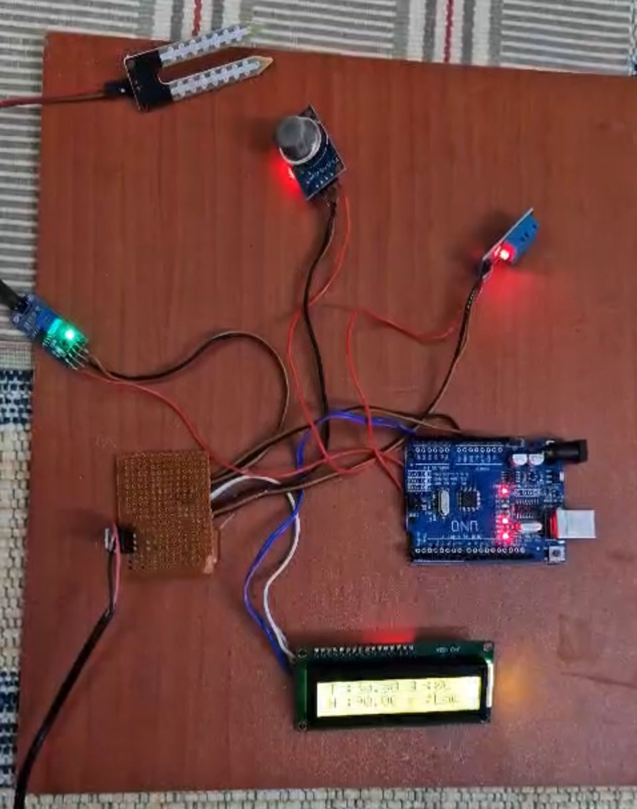
IMPLEMENTATION

